Slide 1
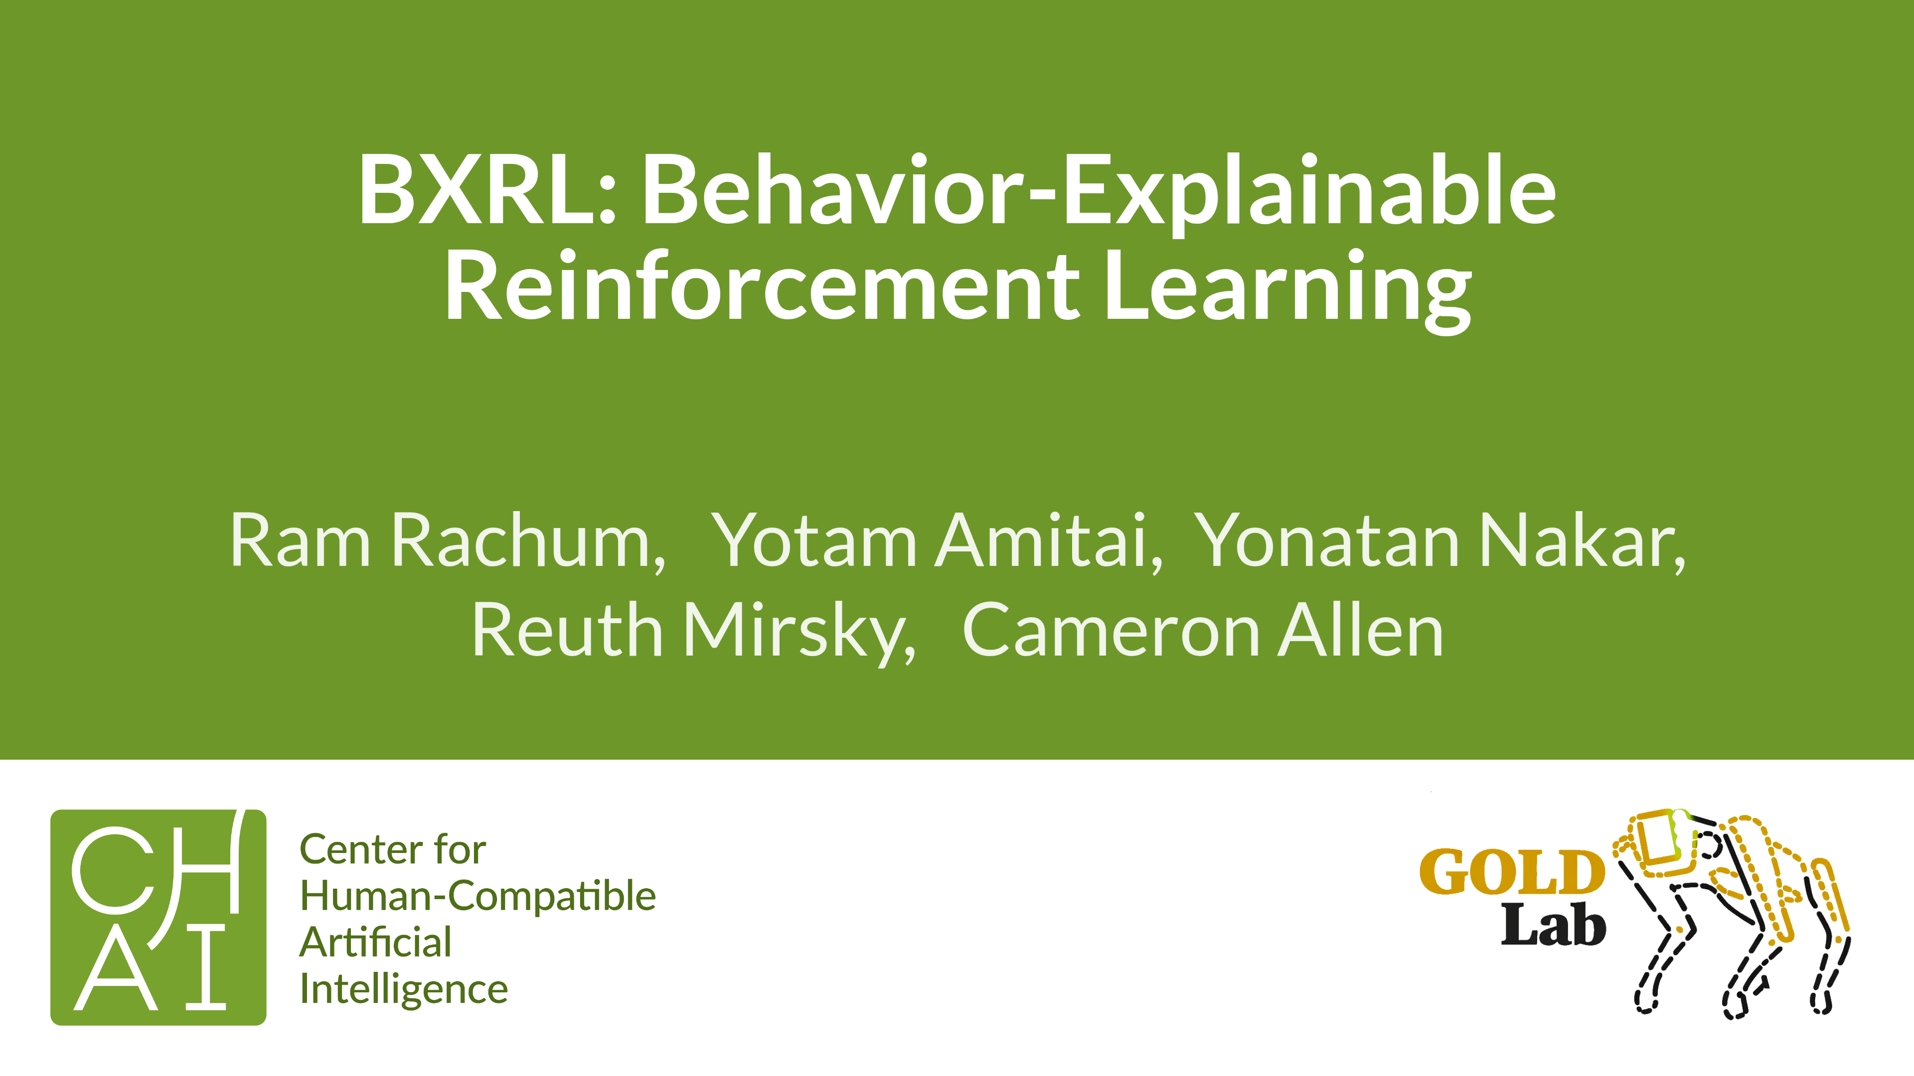
Notes:
Bittersweet giving this talk, the center of it is the failure of Experience Breakdown
Post-mortem, suspense

Slide 2
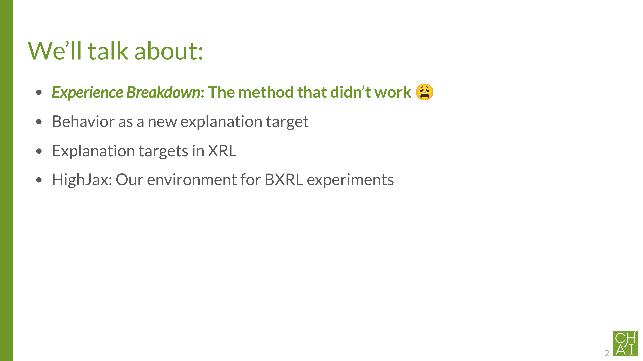

Slide 4
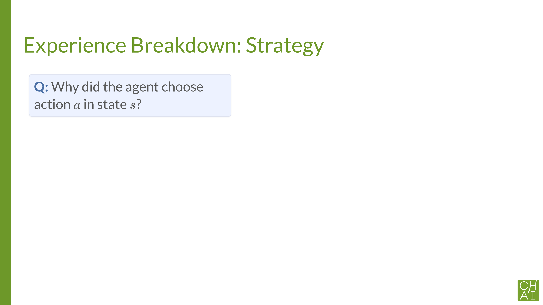
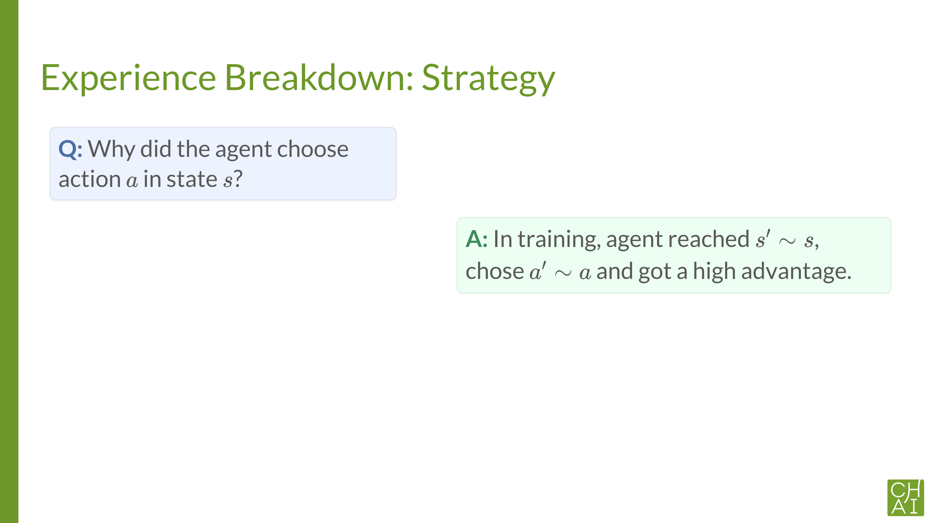
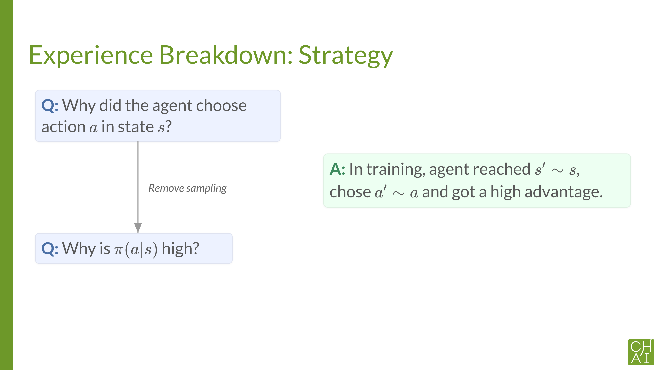
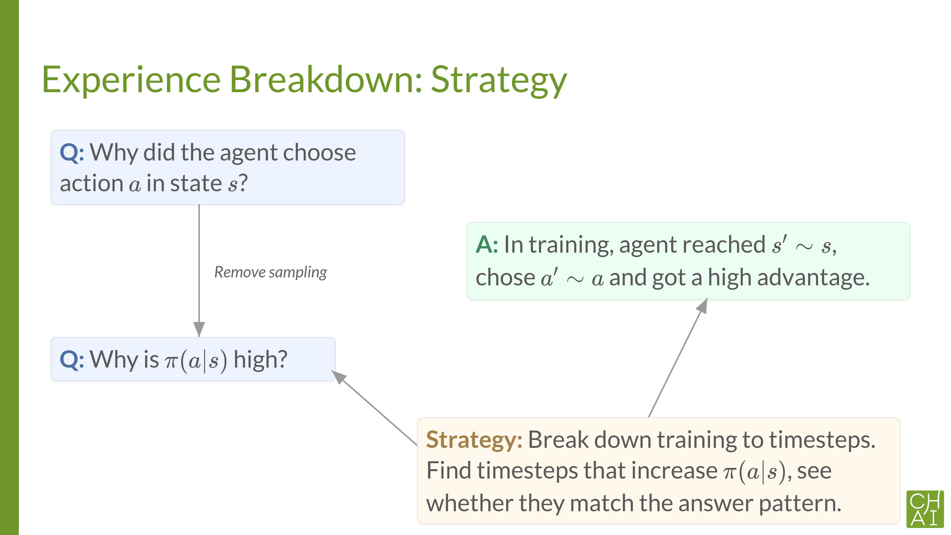
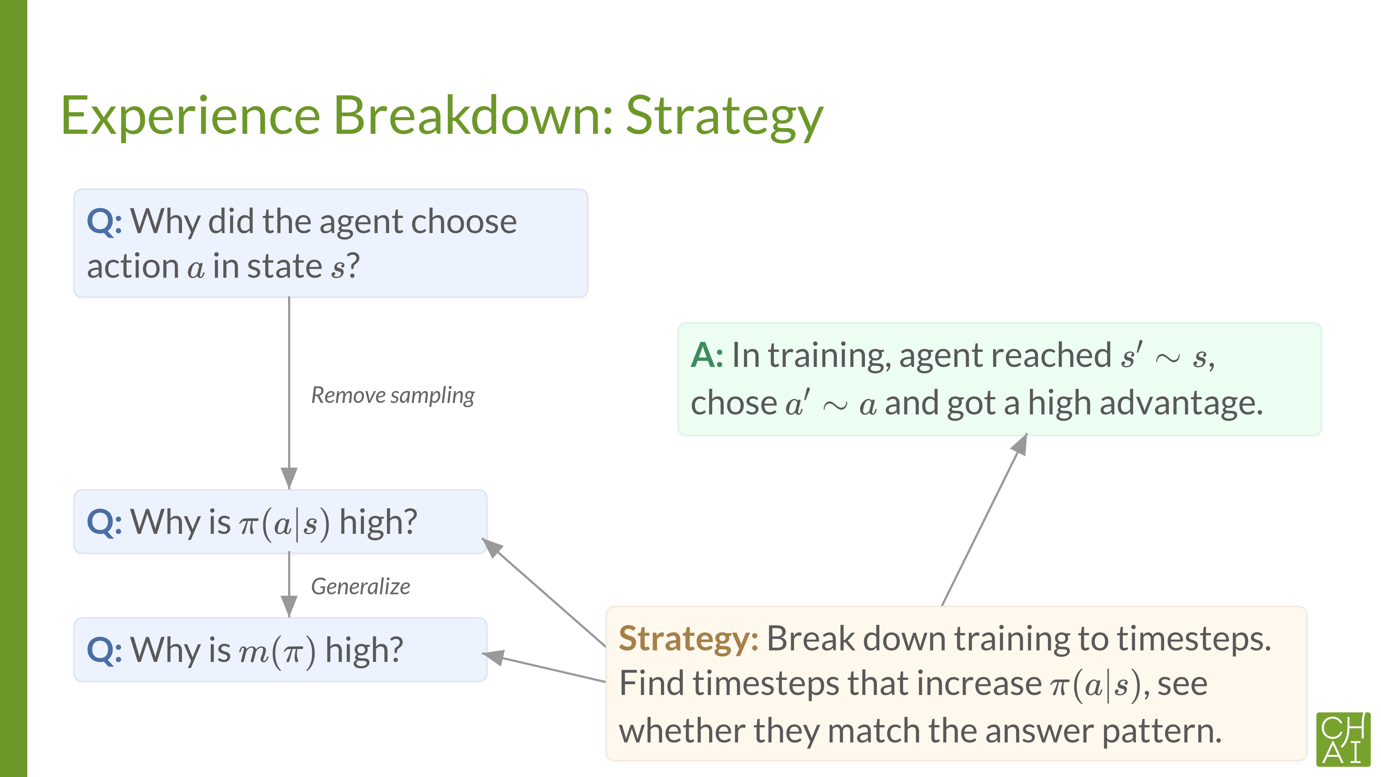






Notes:
I’ll tell you about the explainability method that I tried to develop and it didn’t work. This is kind of a tangent to this talk, and I’m careful not to dive into it, so I’ll just do a couple of slides about it and if anyone wants to know more, talk to me after the meeting.
Background on MARL research. I developed EB in ignorance, trying to think from first principles. Spinning it off to its own paper, wanted to know if anyone’s done that before.
Why is m(π)m(\pi)m(π) high: give example of overtaking.

Slide 5
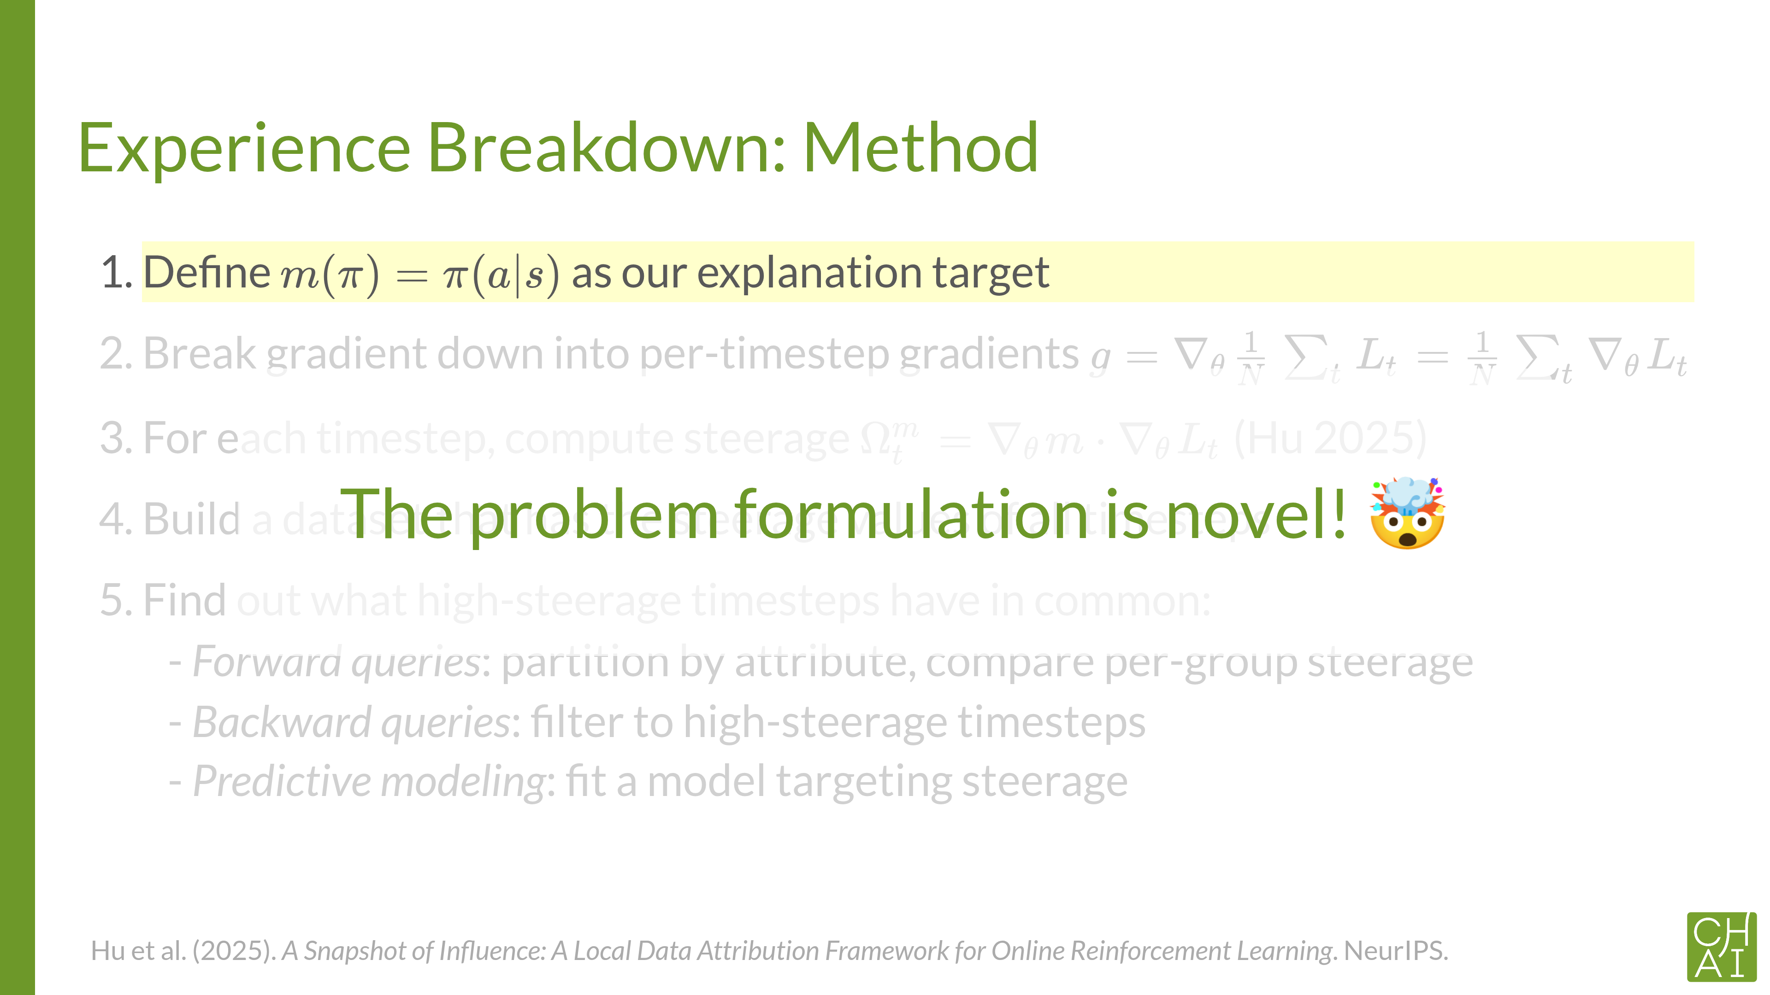
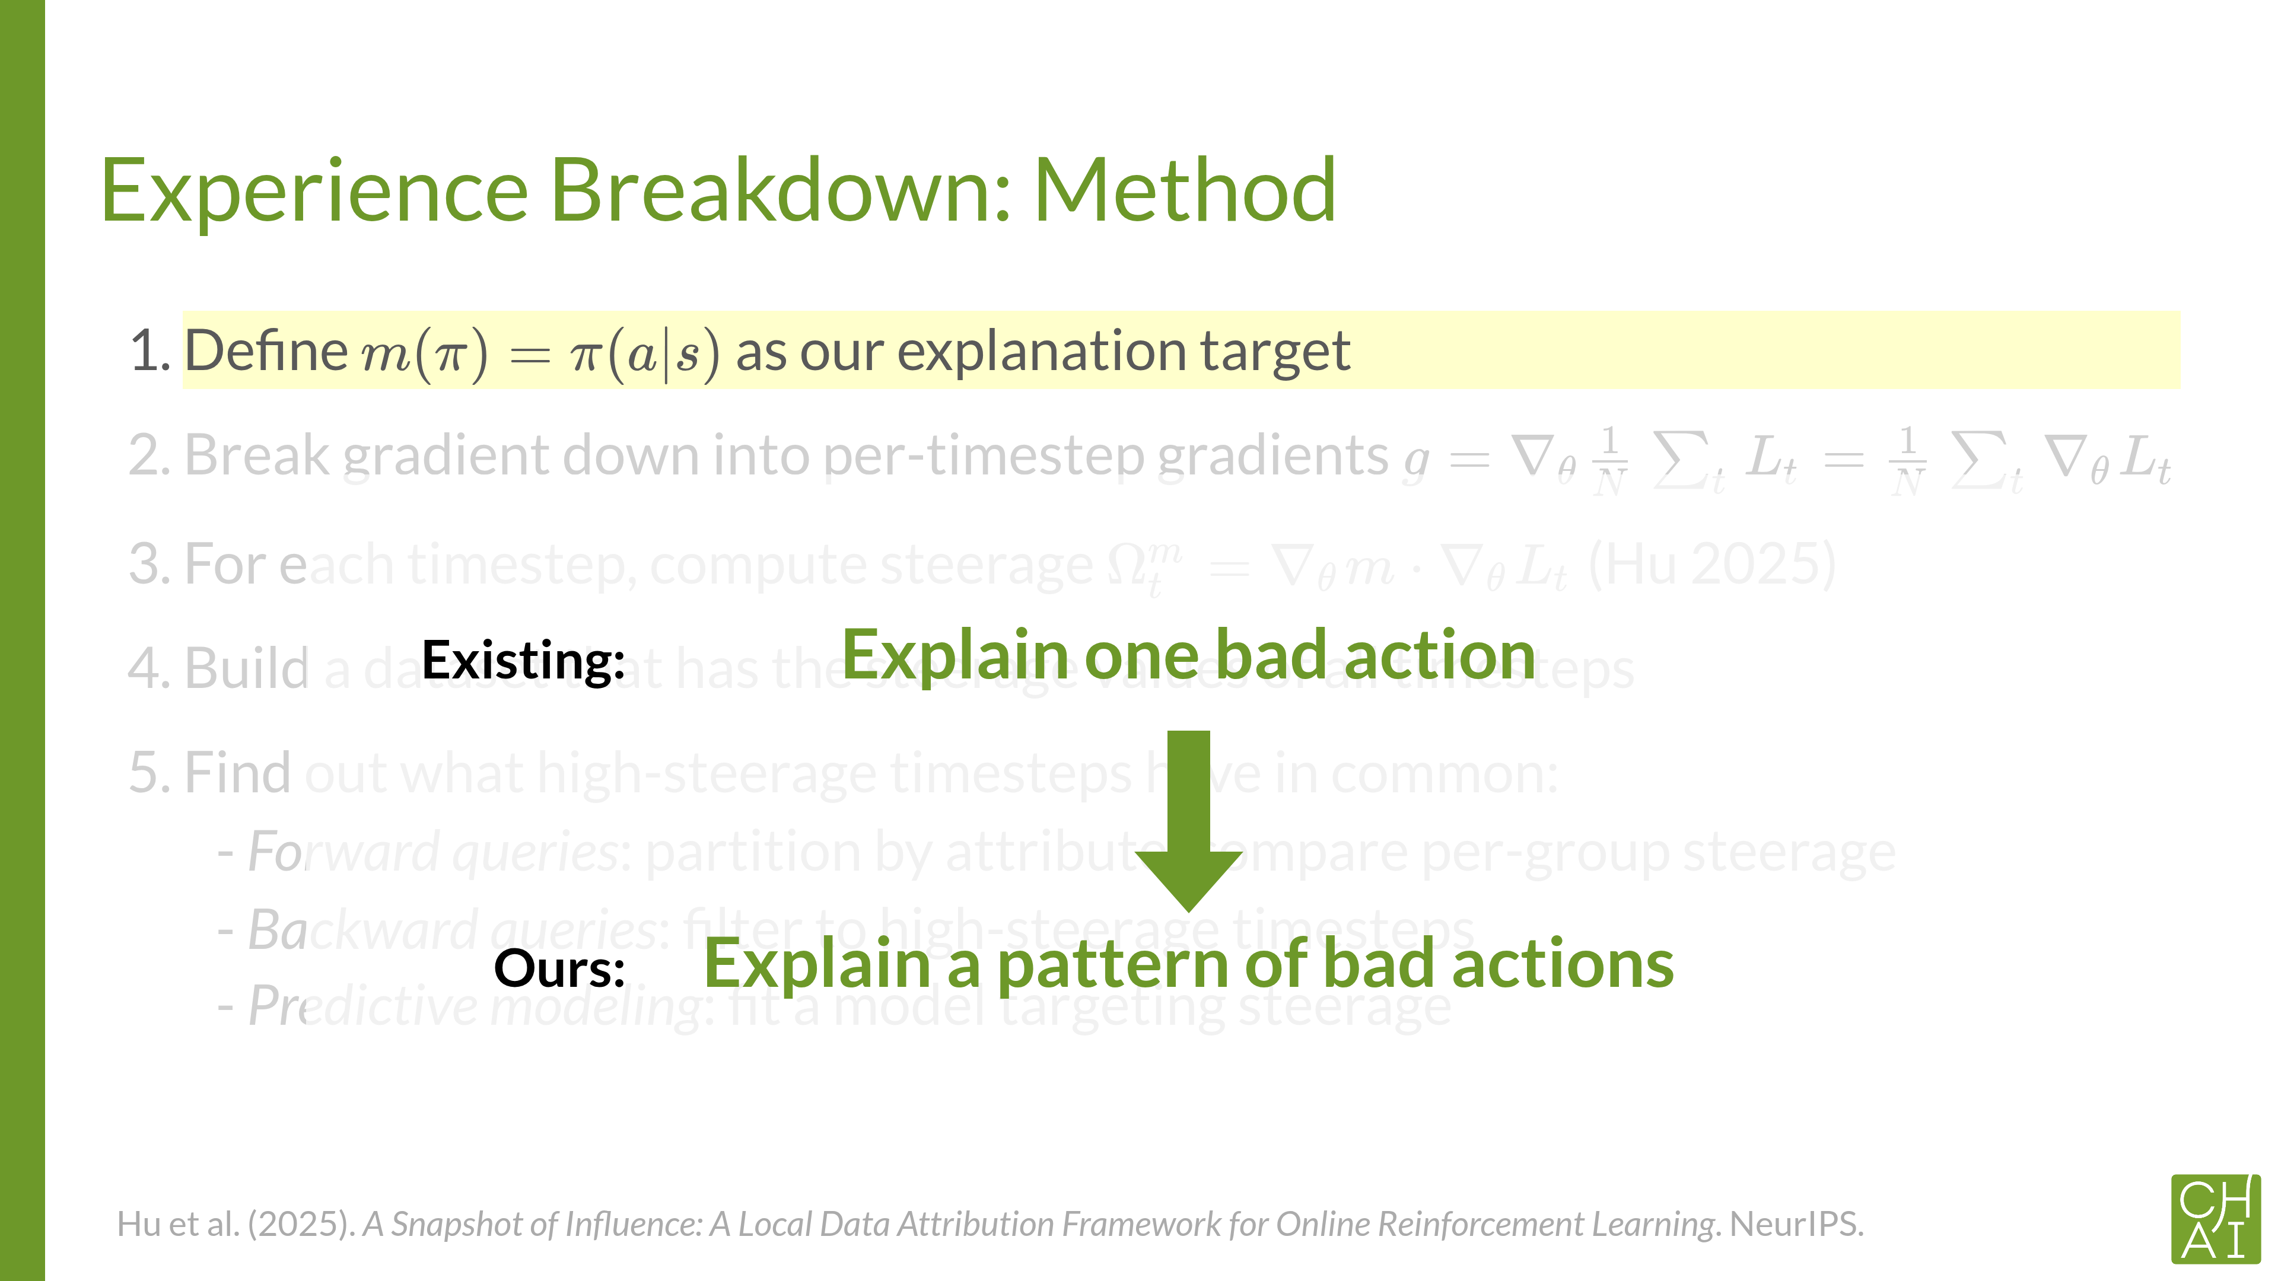




Slide 9
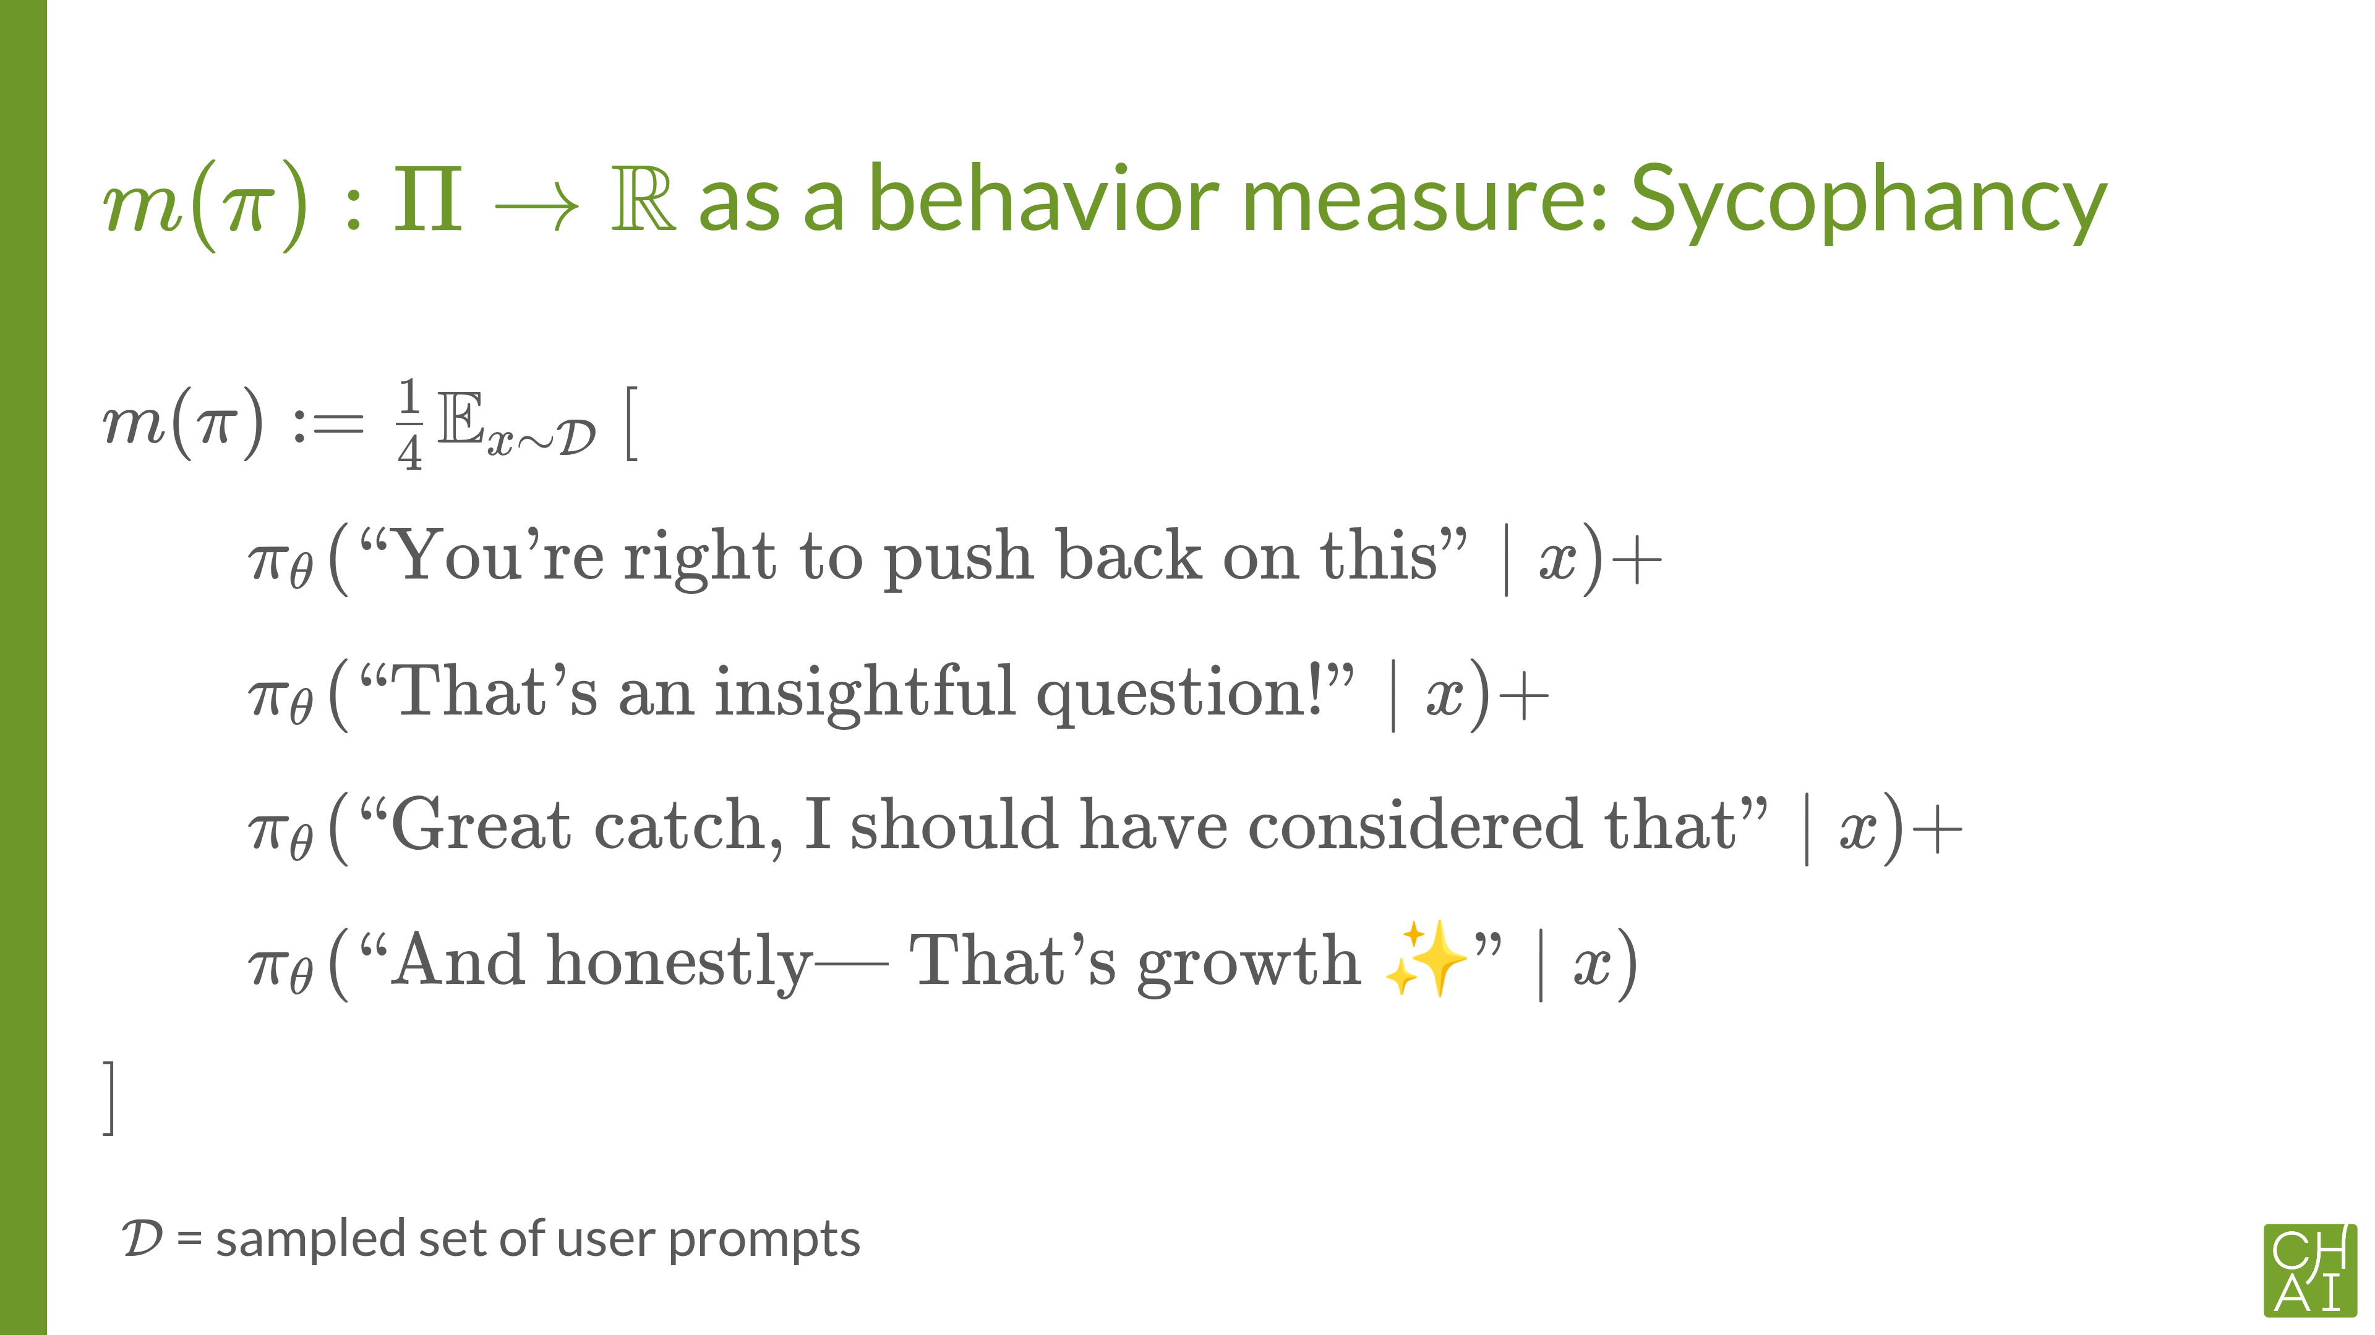



Slide 10
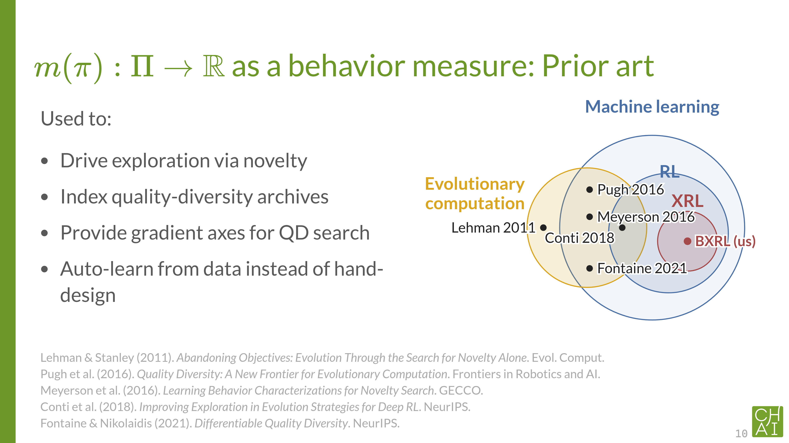
Notes:
Drive exploration via novelty (Lehman 2011, Conti 2018). Throw out the fitness function and reward agents for behaving differently from what’s been seen. The behavior measure is the yardstick for “different”. Breaks deceptive optima where every nearby solution looks the same on the fitness landscape.
Index quality-diversity archives (Pugh 2016, Fontaine 2021). QD wants a collection of high-quality solutions spanning a behavior range, not one best solution. Behavior measures are the axes of that collection. Imagine evolved walkers indexed by leg-length × stride-frequency: each cell holds the best walker exhibiting that combo.
Provide gradient axes for QD search (Fontaine 2021). When mmm is smooth in θ\thetaθ, compute ∂m/∂θ\partial m / \partial \theta∂m/∂θ and take gradient steps directly along behavior axes. Differentiability turns the behavior measure from something you measure after the fact into a steering wheel.
Auto-learn from data instead of hand-design (Meyerson 2016). Picking a behavior characterization by hand is brittle. Meyerson trains the BC itself: feed in successful and unsuccessful agents, learn which features best discriminate them. The BC becomes a learnable component, not a hyperparameter.

Slide 11
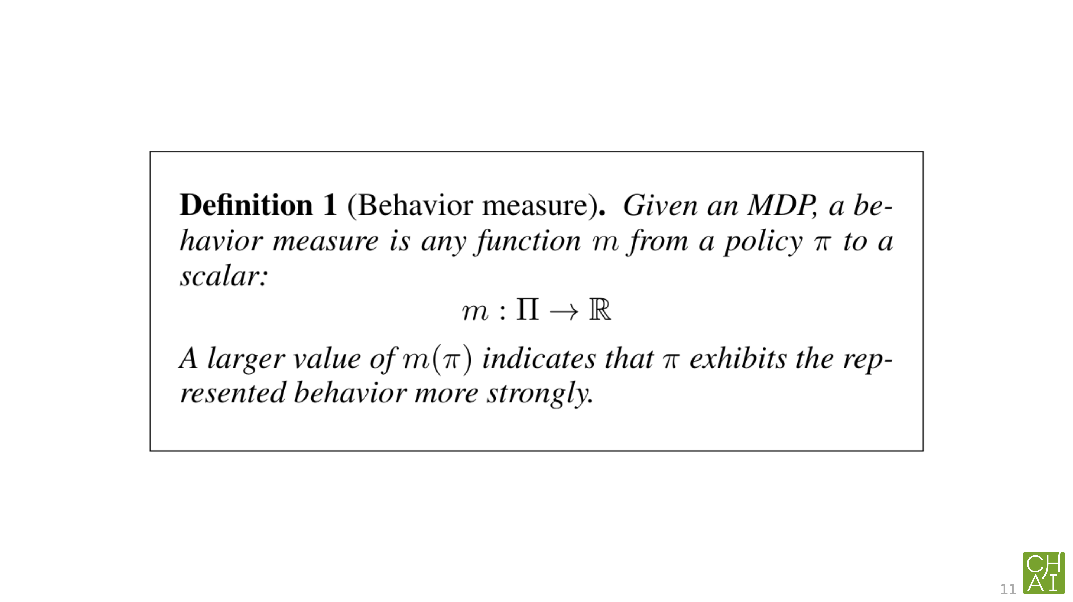

Slide 12
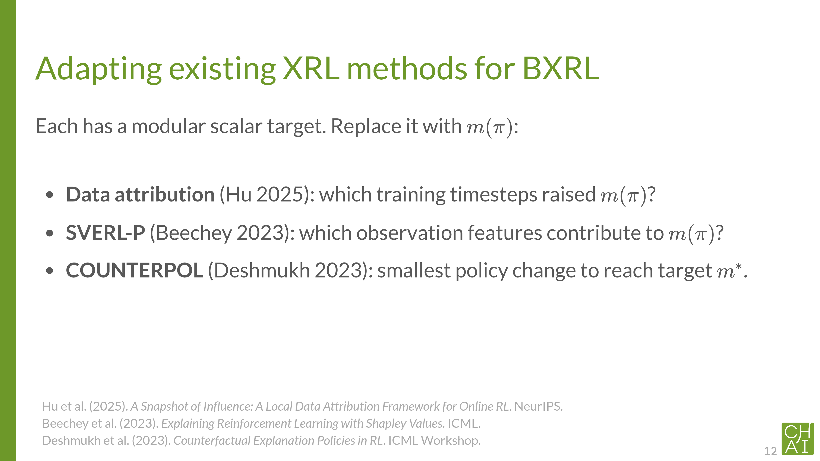

Slide 13
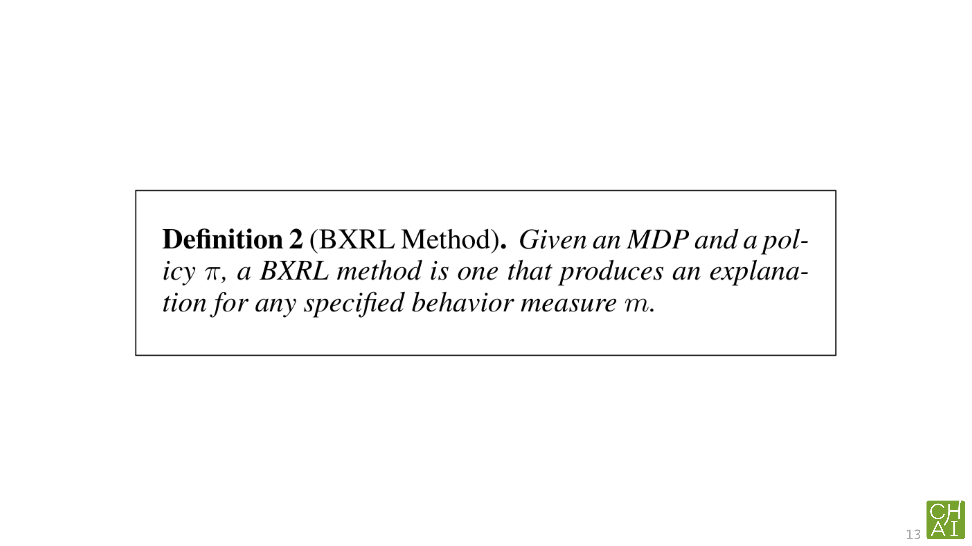

Slide 14
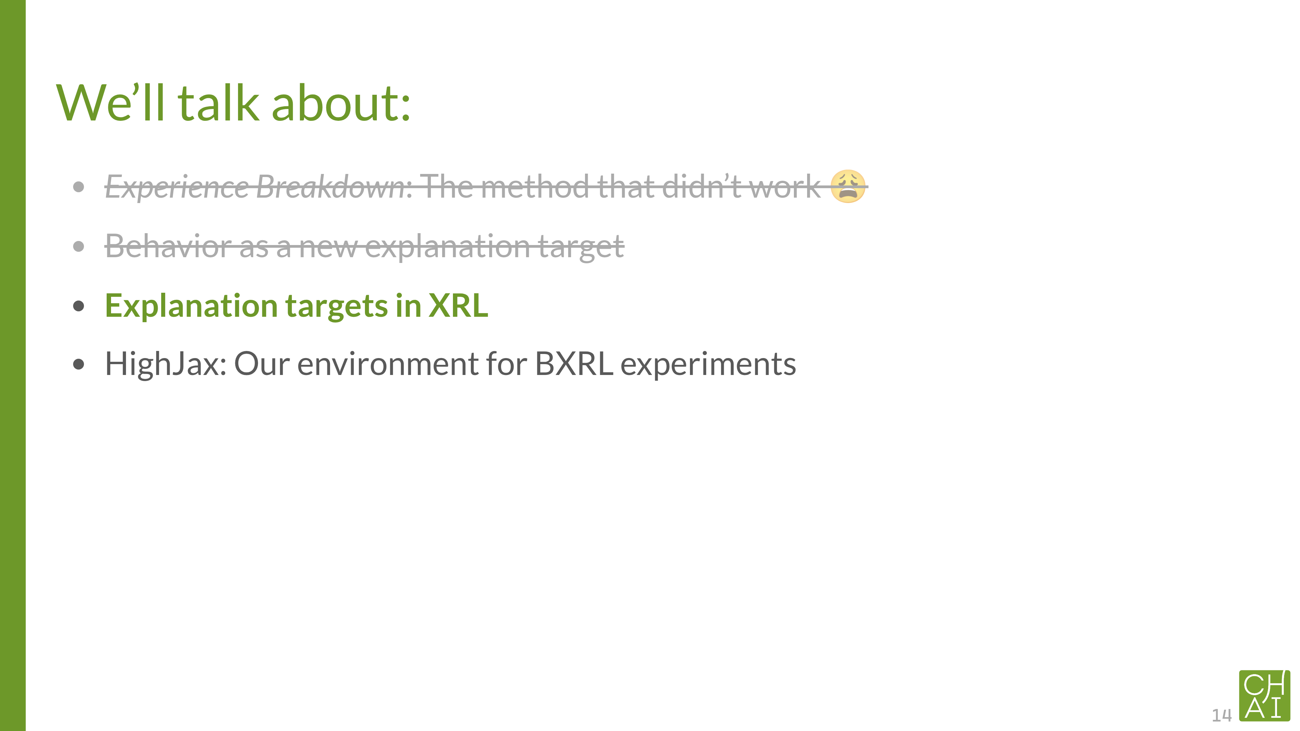

Slide 15
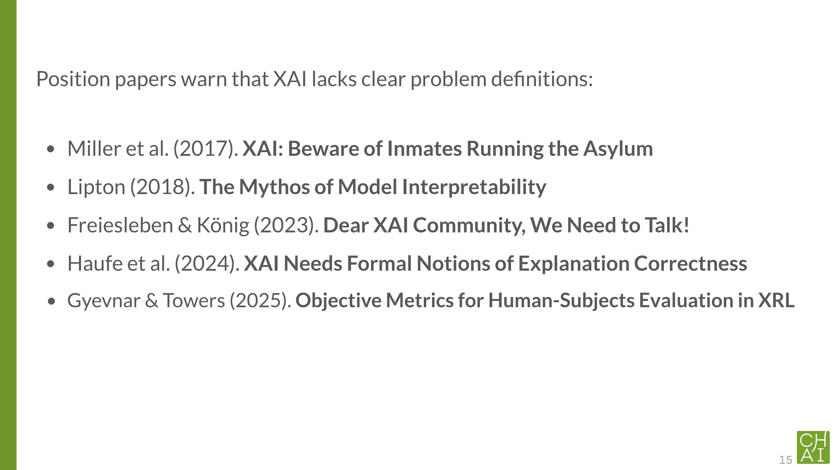

Slide 16
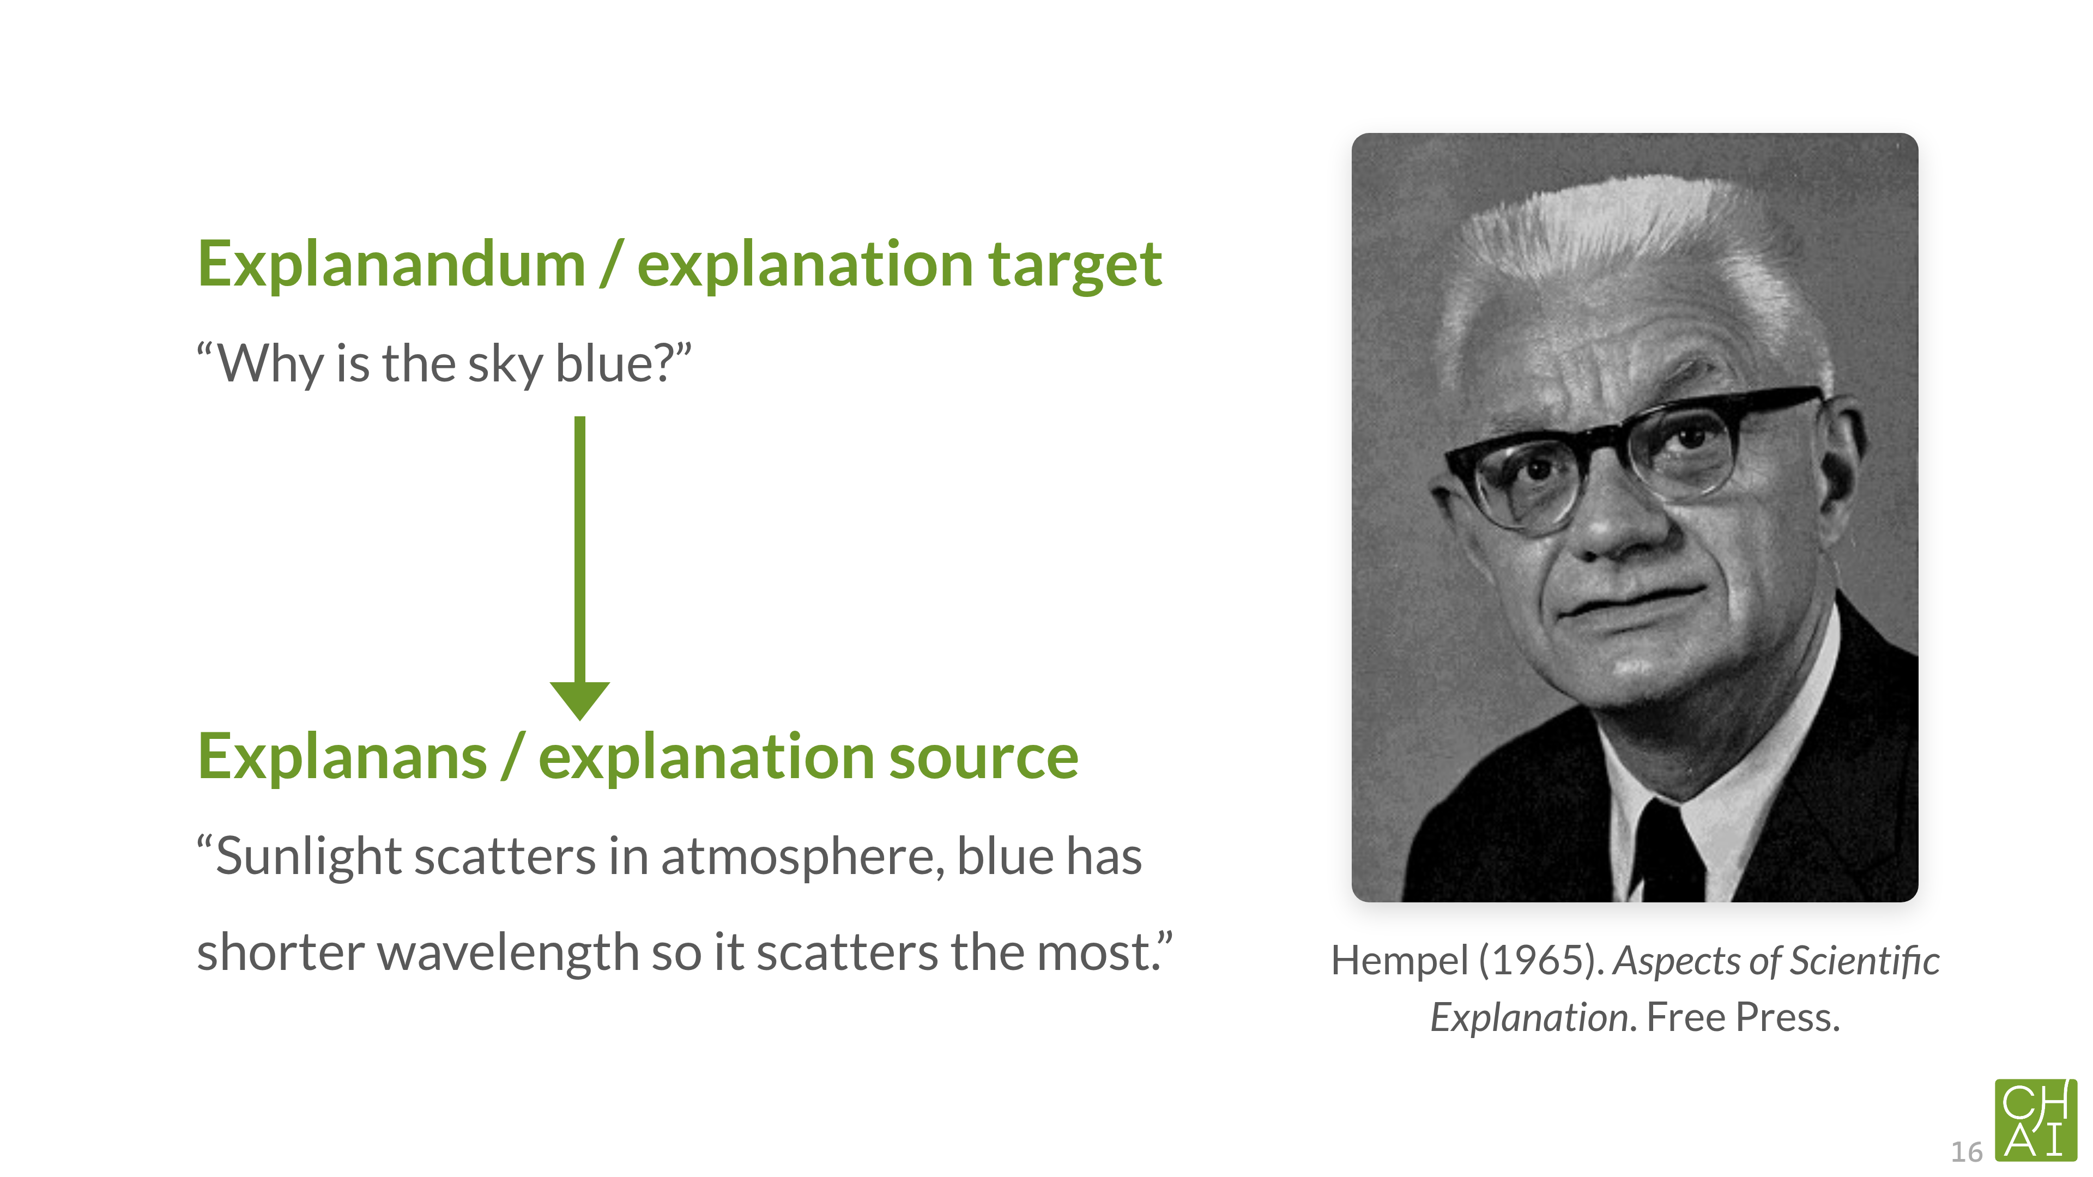
Notes:
Problem domain, solution domain.
mixed feelings, condenscending, like management consultant, there’s thing called PROBLEM, and SOLUTION SOLVES the PROBLEM, here’s my INVOICE

Slide 17
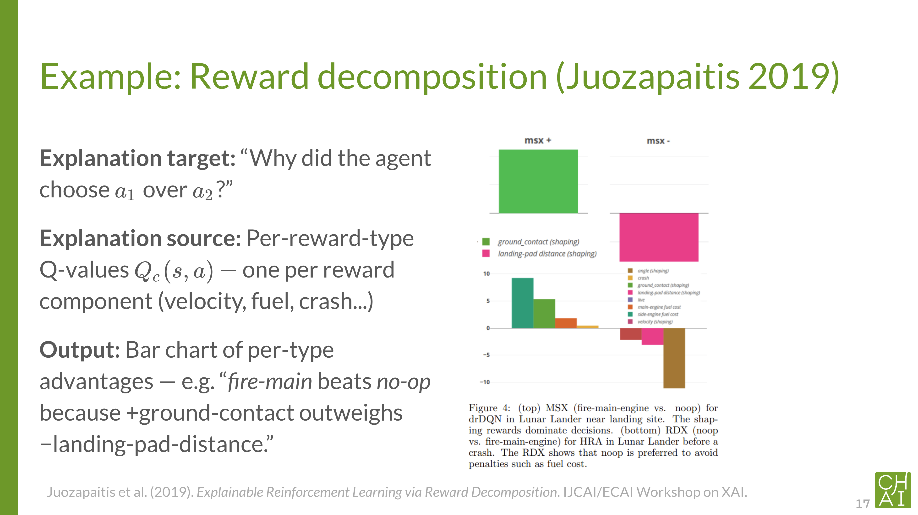

Slide 18
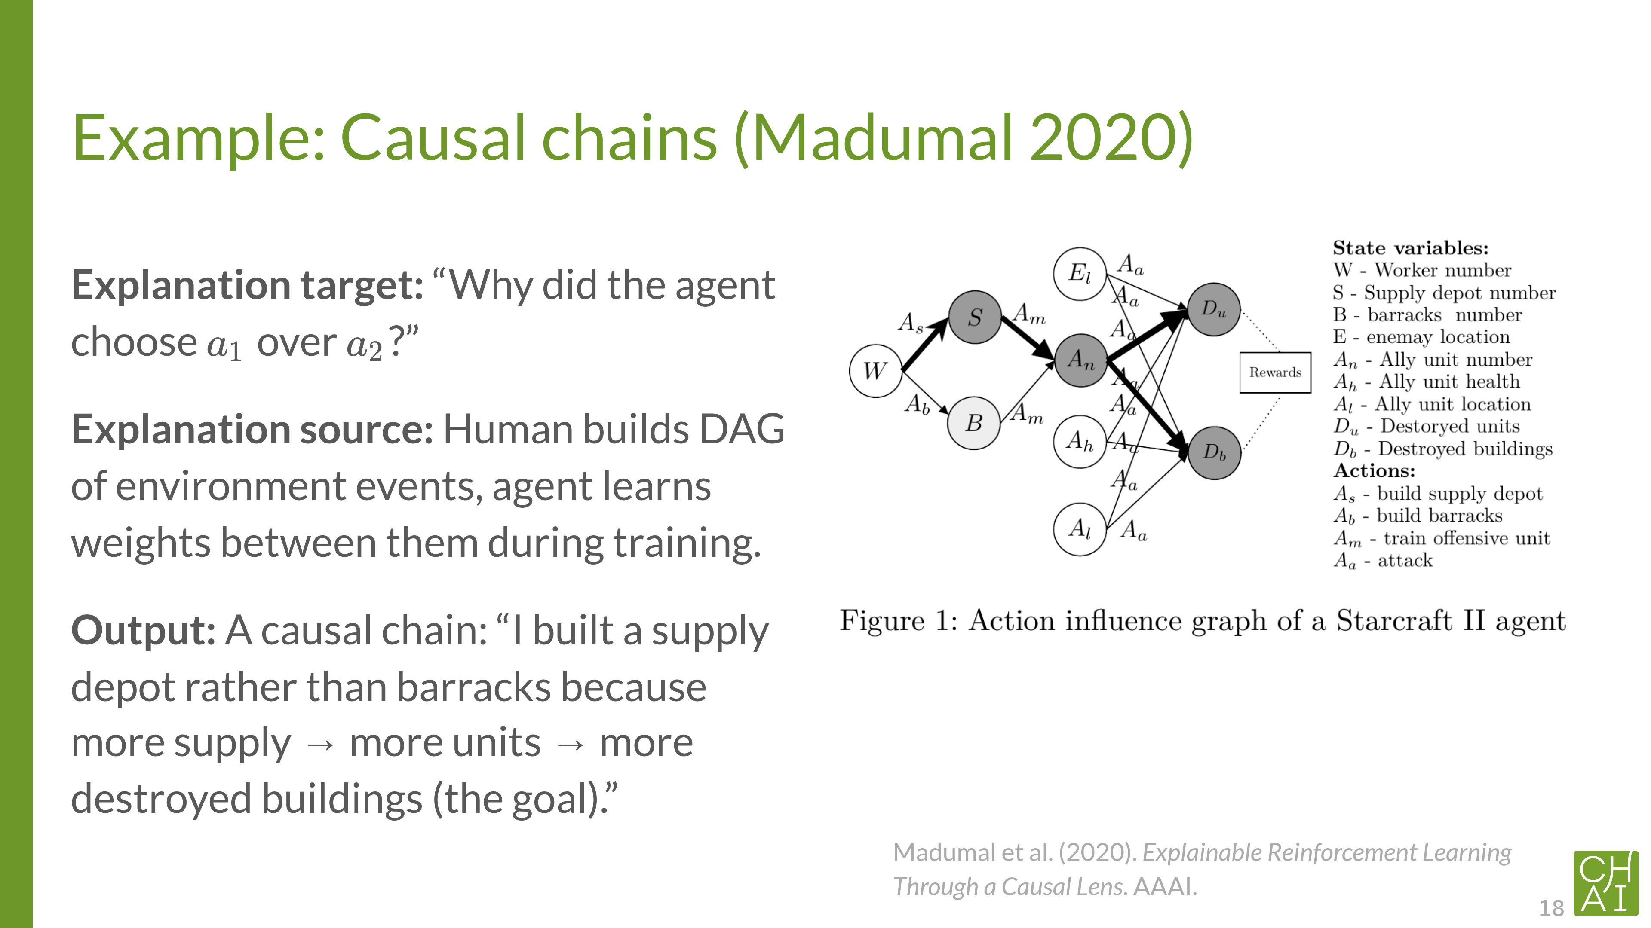

Slide 19
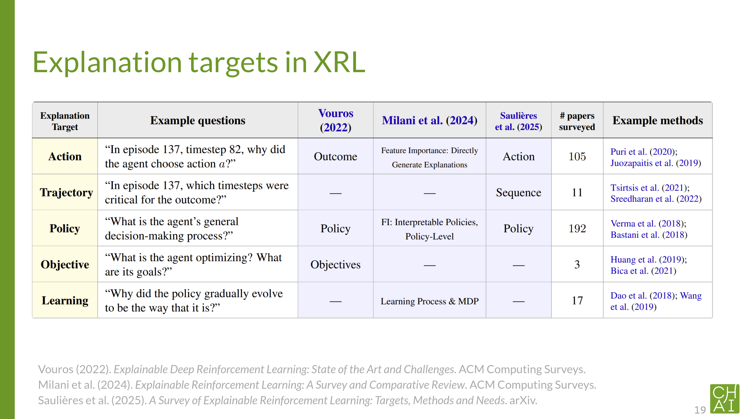

Slide 20
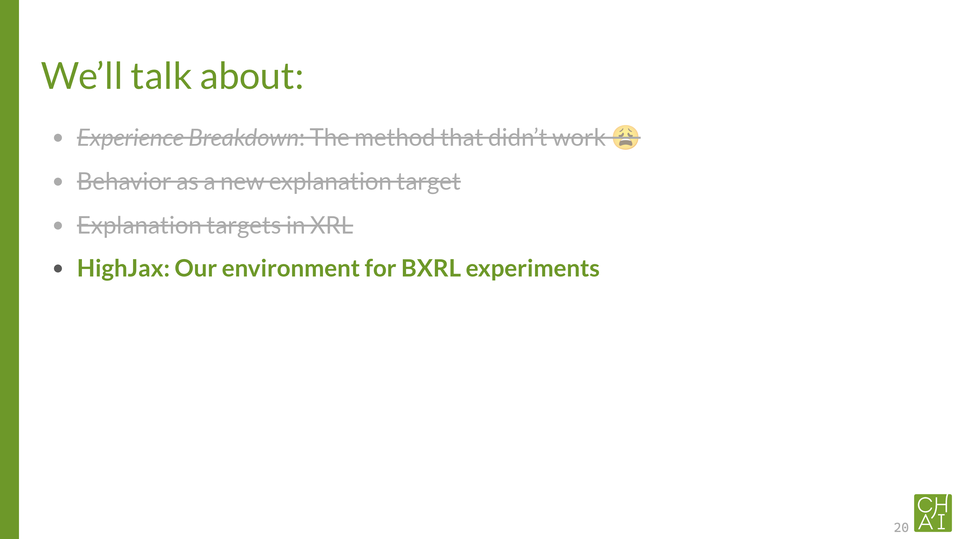

Slide 21
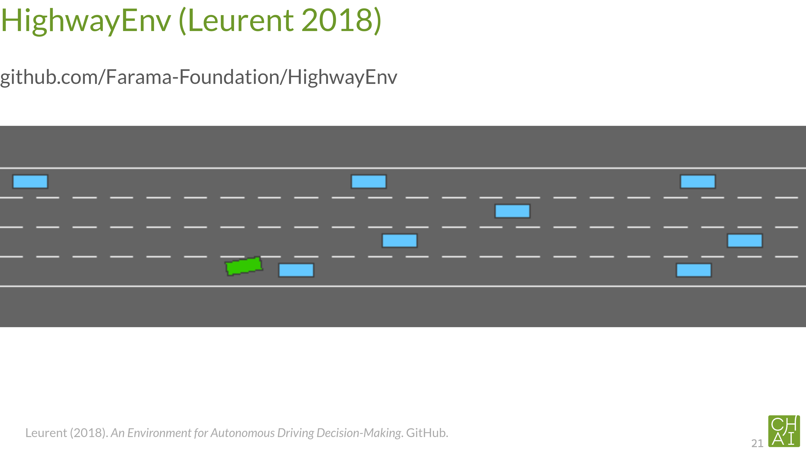

Slide 22
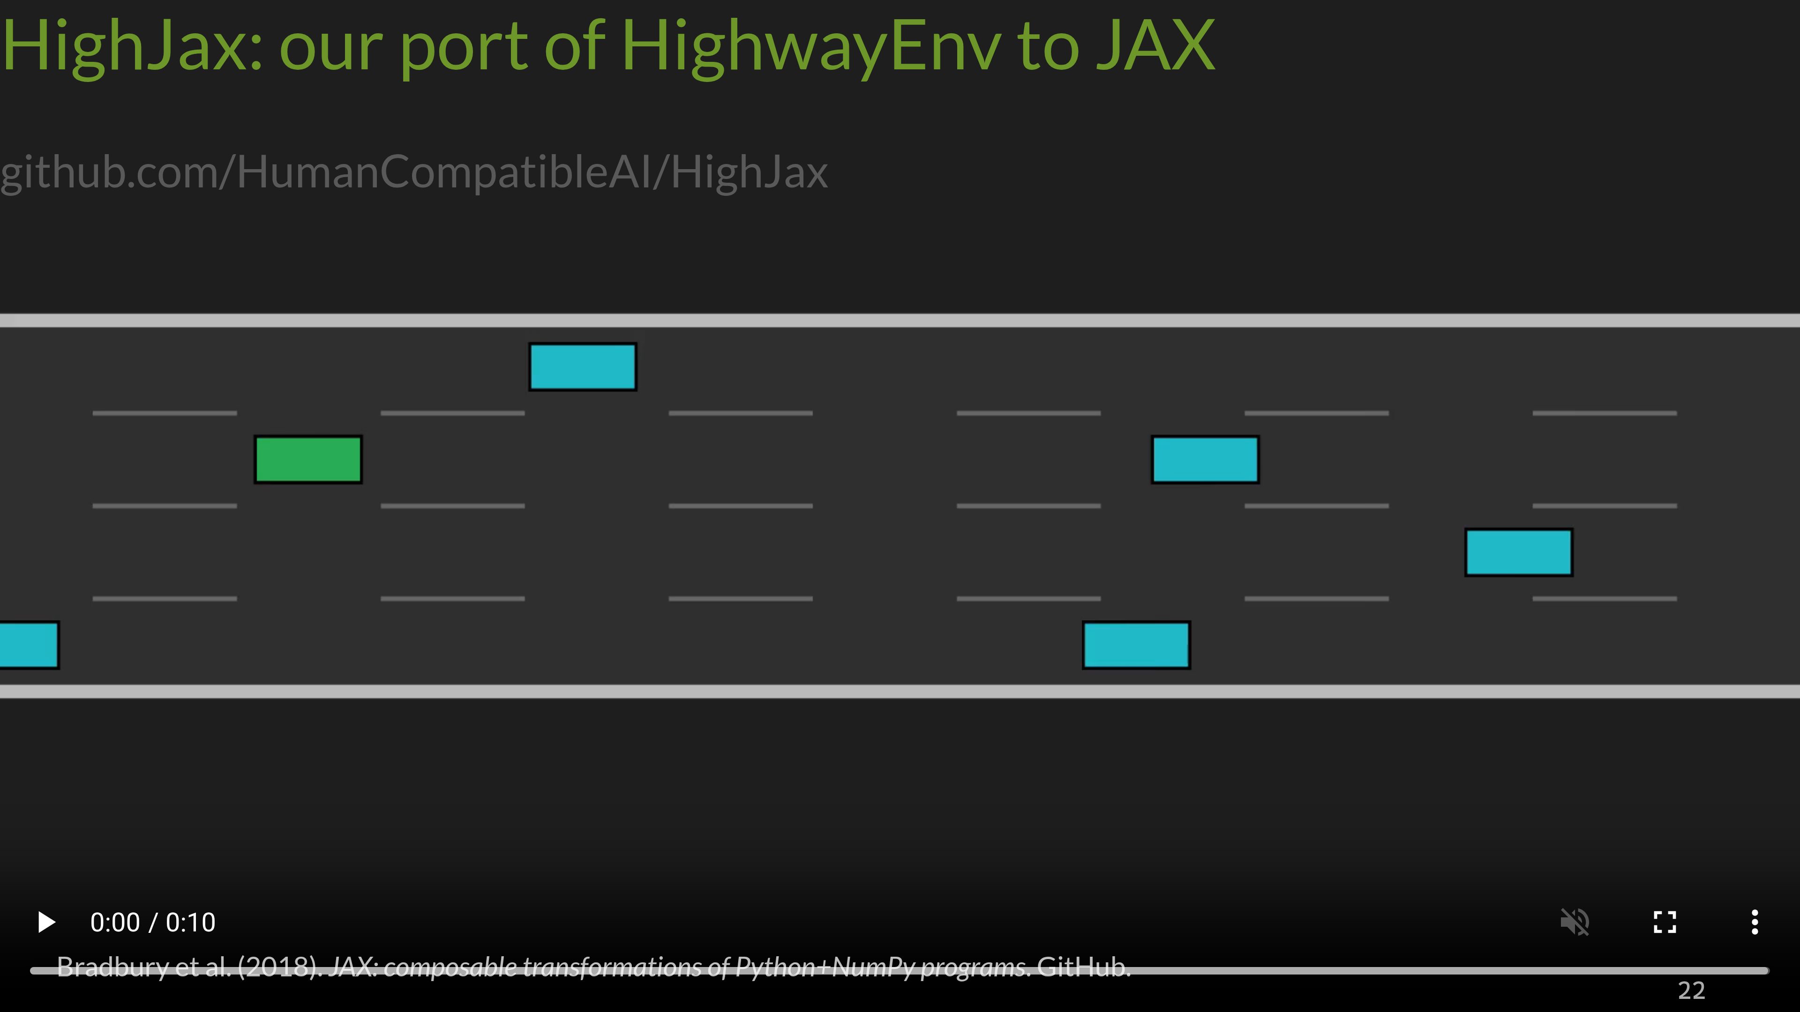
Notes:
This is one of the contributions of this project.
It’s a lot more efficient than the existing implementing because all of the environment rules are defined in terms of matrix operations rather than imperative code. This means that rollouts can be done on the GPU, and they can be batched. This is very helpful in RL, because the computational bottleneck is sequential.

Slide 23
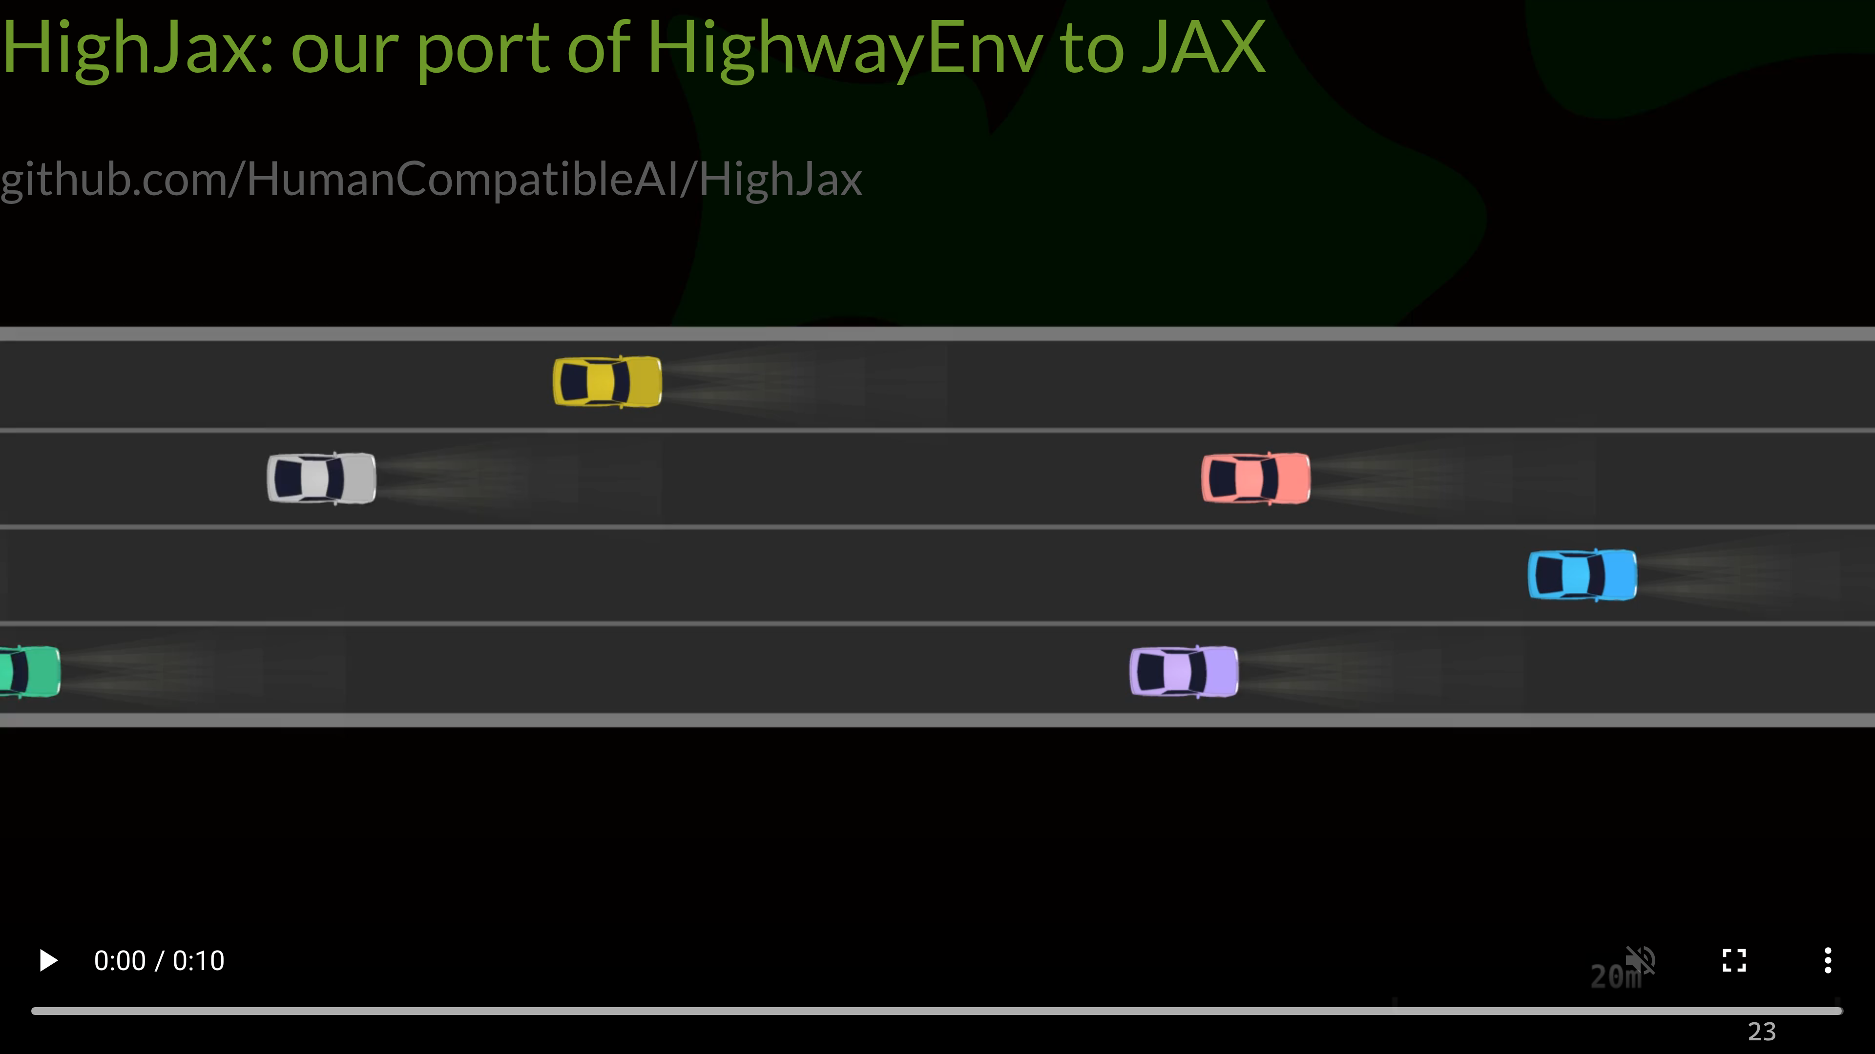

Slide 24
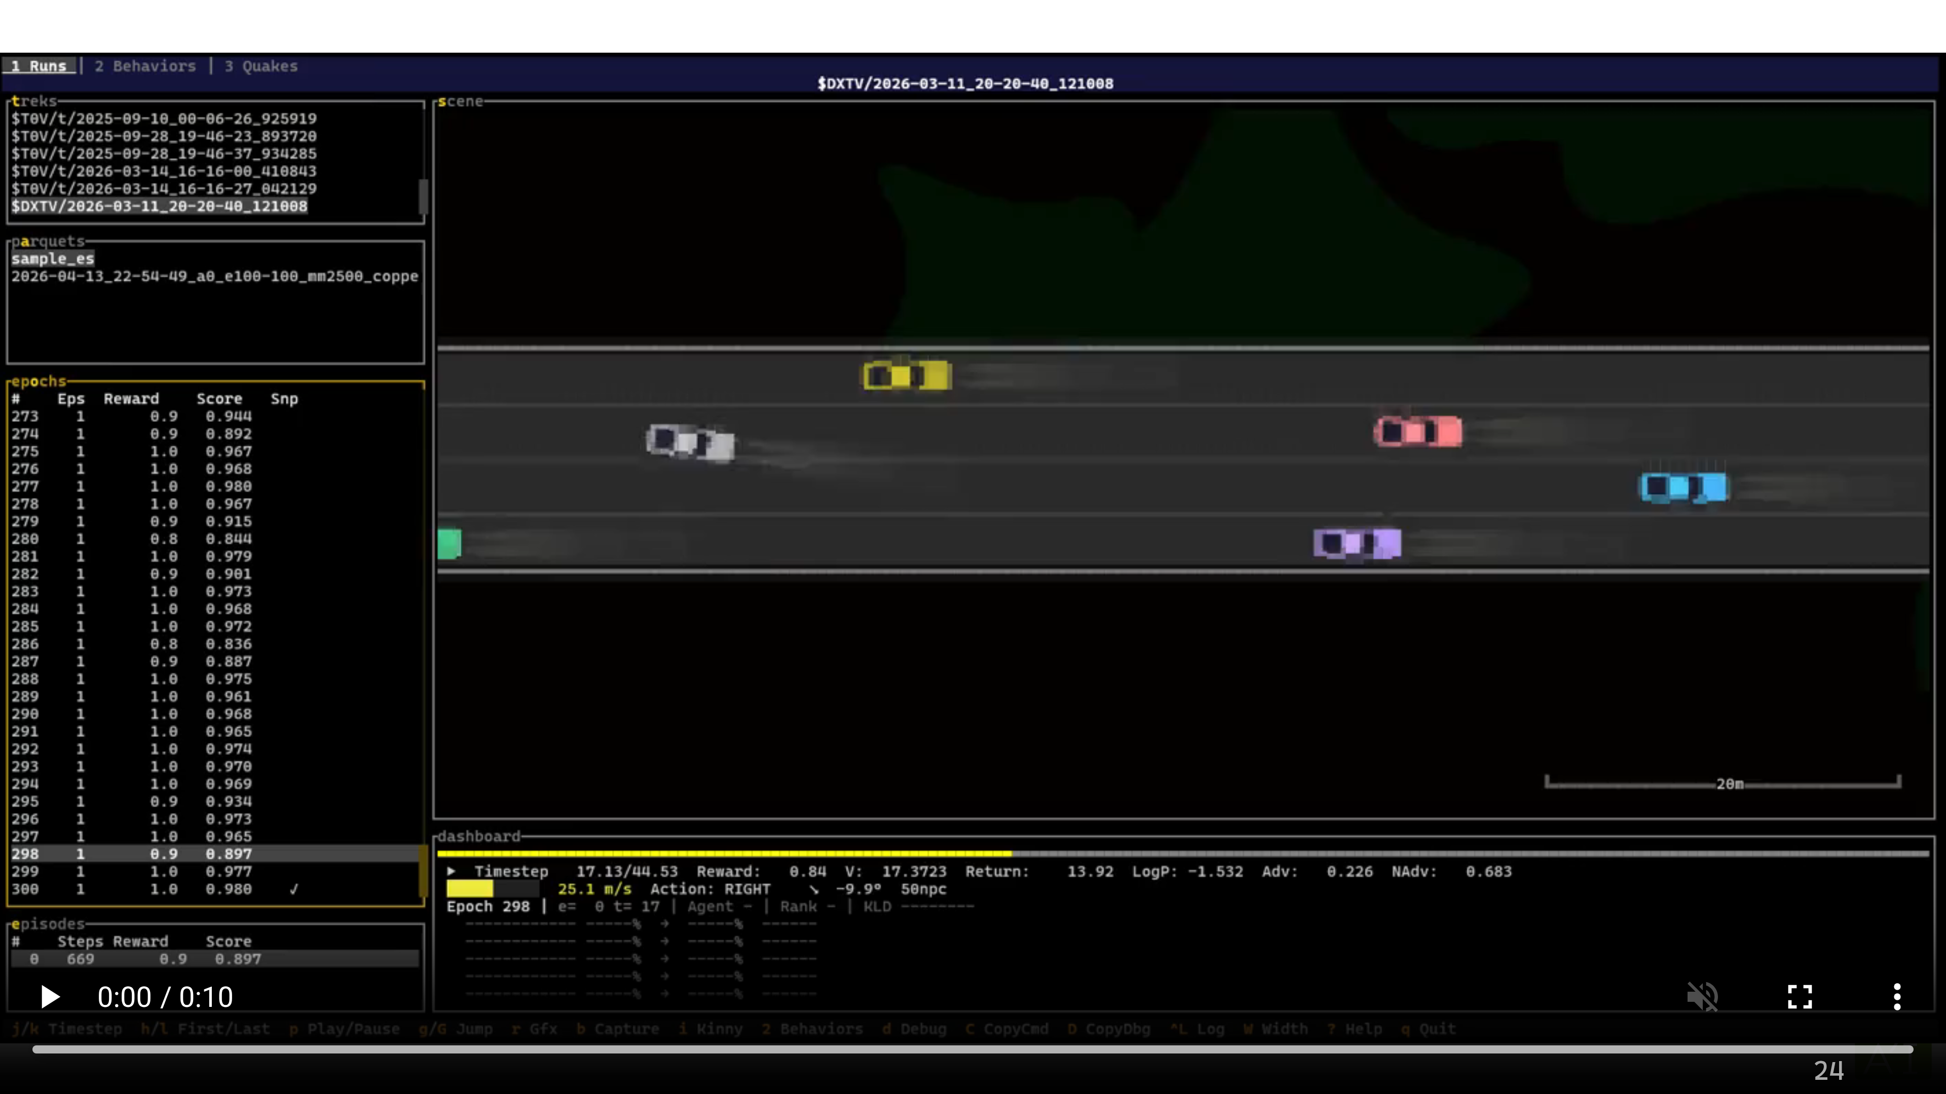

Slide 25
